Slide 1
Logistic regression
Epco Hasker
Institute of Tropical Medicine

Slide 2
1st lecture on logistic regression
Rationale behind logistic regression
Equation, parameter estimates
Likelihood
Likelihood Ratio (LR) test, Wald test
Models with > 1 explanatory variable
Comparison of models
Notes:
In this lecture we will look at the rationale behind, logistic regression, explain equation and parameter estimates, look at the concepts of likelihood and Likelihood Ratio (LR) test as well as Wald test. Also we will look at models with > 1 explanatory variable and compare models.
In this lecture I will switch between PowerPoint and R Commander and occasionally to Excel. To have an optimal understanding please try to also do the R Commander or Excel examples yourself.

Slide 3
Why use regression techniques? (1)
Regression techniques developed to overcome limitations of classical techniques based on tables and stratification
Notes:
Regression techniques were developed to overcome limitations of classical techniques based on tables and stratification, in particular the issue of spreading data too thin when adjusting for multiple confounders.

Slide 4
Limitations of stratification: Study with 200 observations
Control for confounding by sex: 100 observations/stratum
Plus control for confounding by age quartile: 25 observations/stratum
Plus control for confounding by wealth quintile: 5 observations/stratum
Problem: stratum-specific ORs instable, some strata not contributing to MH-OR
Notes:
In this example you see how from one 2x2 table we go to 40 tables when stratifying on 3 variables of which one has 5 levels. As a result we will have lots of empty cells and odds ratios become instable.

Slide 5
Why use regression techniques? (2)
Control for multiple confounding simultaneously, i.e. obtain valid estimates for exposure(s) of interest
Make predictions about outcome variable depending on several exposure variables simultaneously
Take interaction by variable I and confounding by variable C into account simultaneously
Notes:
Regression methods can control for multiple confounders at the same time, can deal with variables with multiple levels such as wealth quintile, and can deal with interaction and confounding at the same time.

Slide 6
Which method?
Dependent variable | Example | Method
Numerical | Blood pressure, weight, temperature | Linear regression
Dichotomous | Death, disease, hospital admission | Logistic regression
Count | Number of deaths, number of relapses | Poisson regression
Time until a dichotomous event | Time till death, Time till relapse | Survival analysis
Notes:
Which method to choose depends most of all on the outcome variable as we already saw during the introduction last week. If the outcome variable is binary and time till event does not matter, logistic regression is the most appropriate technique. Please do note though that logistic regression calculates odds ratios, not risk ratios. If a condition is rare, the odds ratio is a good approximation of the risk ratio, if a condition is common (e.g. > 10%) the odds ratio tends to exaggerate the strength of the association.

Slide 7
Why logistic regression?
Linear regression: appropriate for continuous outcome variable as weight, height, blood pressure etc; not appropriate for discrete (and binary) outcome variable, as survival/death, healthy/diseased
Logistic function
corresponds well to binary effect
Notes:
In regression methods we try to represent what we observe by a model, this is done using a ‘link function’. If the association is linear, e.g. the association between age in months and weight of children age 1-2 years, it is best represent by a straight line, such as in the first graph, the equation is y = a + bx. But if the dependant variable is binary, e.g. dead/alive or ill/ not ill, a straight line is not a good model. In that case we want a model that for most values of x results in 1 (positive) or 0 (negative) for y. This can be achieved by the logistic function, 1 over 1 + e to the power of minus x. This is the link function on which logistic regression is based, shown in the second graph.
Example in Excel x - -20 to +20 Y1 = 20+10x , Y2 = 1/(1+e-x) Move labels to low

Slide 8
Equation in logistic regression
Equation: log odds(y) = b₀ + b₁x₁ + b₂x₂ + … b_{i}x_{i} where
y = binary outcome variable
x_{i} = exposure variables (numerical by default)
b₀ = log odds of baseline group (= unexposed to all independent variables)
b_{i} = log odds ratio for x_{i}
log = logarithm to basis e ( = natural logarithm ln)
Notes:
In fact what we do in logistic regression is to model on the log odds. So the outcome of our logistic regression is the log odds, the natural logarithm of the odds, which can be converted to odds by exponentiating it. So the equation is: log odds(y) = b₀ + b₁x₁ + b₂x₂ + … b_{i}x_{i.}

Slide 9
Logistic regression
Used to model binary outcomes
Estimates log OR
Cannot be calculated
Iterative process (trial and error)
Uses maximum likelihood estimation (MLE)
Notes:
So logistic regression is used to model binary outcomes and estimate the log odds ratio. It cannot be calculated but is approximated through an iterative process through which the software identifies the values with the highest likelihood, maximum likelihood estimation (MLE). It is similar to linear regression where we calculated the values of a (intercept) and b (slope) that resulted in the lowest residual variance. But MLE cannot really be calculated, the software just tries out different values and retains the ones that result in the highest likelihood. It uses algorithms that allow doing so with a minimum number of trials or ‘iterations.’ We will see an example later.

Slide 10
Logistic regression
 | Case
Exposed | Yes | No
Yes | 17 | 13 | 30
No | 190 | 986 | 1176
 | 207 | 999 | 1206
Odds cases:
Odds non cases:
OR:
Notes:
First look at this slide on the association between a certain disease and a certain exposure. What is the odds of exposure among the cases, odds of exposure among the non-cases and what is the odds ratio?

Slide 11
Logistic regression
 | Case
Exposed | Yes | No
Yes | 17 | 13 | 30
No | 190 | 986 | 1176
 | 207 | 999 | 1206
Odds cases: 17/190
Odds non-cases: 13/986
OR: 6.786235
Notes:
I hope you agree that it is as follows: Odds exposure among diseased: 17/190, Odds of exposure among controls: 13/986, OR:6.786235. Now use Excel or a calculator to calculate the natural log of all three.

Slide 12
Logistic regression
 | Case
Exposed | Yes | No
Yes | 17 | 13 | 30
No | 190 | 986 | 1176
 | 207 | 999 | 1206
Odds cases: 17/190 log odds: -2.41381
Odds non-cases: 13/986 -4.32871
OR: 6.786235 log OR: 1.91490
Notes:
Do you find 0.268 for the log odds of the cases and -1.647 for the log odds of the non-cases? To get the odds ratio you divide the odds of the cases by the odds of the controls. But if you are working with logarithms instead of dividing you have to subtract. (10^3 / 10^2 = 10^(3-2)), so the log odds ratio will be 2.41381 – -4.32871 = 1.191490. e to the power of 1.191490 = 6.79, which is the odds ratio. Please try for yourself.

Slide 13
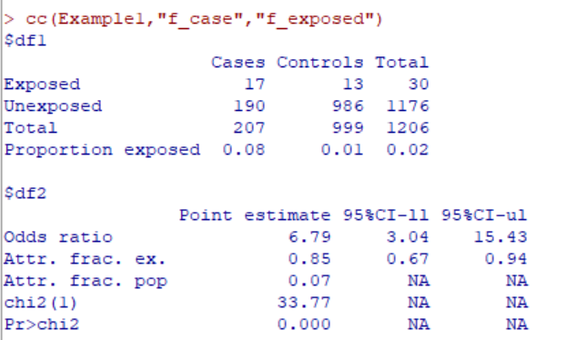
Bivariate analysis (R)
Notes:
Now I go to R Commander and import the csv dataset called ‘Example1’. I also load the ‘Epistats’ package. Next I convert ‘case’ and ‘exposed’ from numerical to factor using ‘f_’ as a prefix and FALSE for 0 and TRUE for 1. Then I use the command cc(Example1, “f_case”, f_exposed”). As you can see, we get an odds ratio of 6.79.

Slide 14
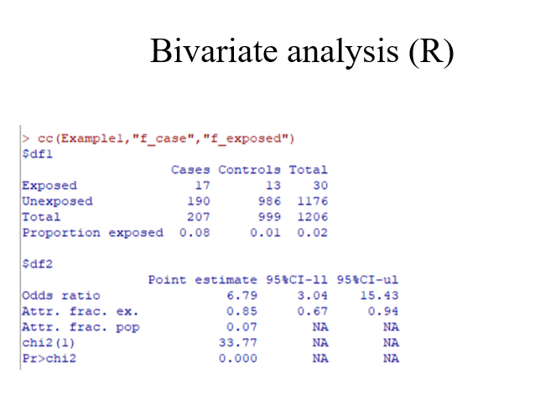
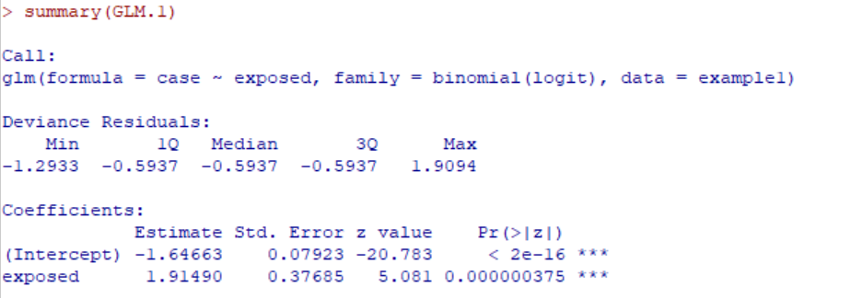
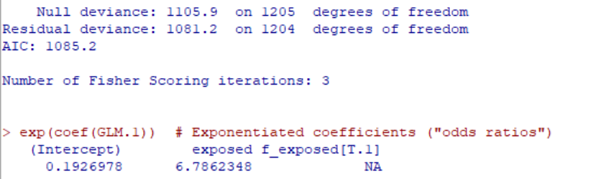
Logistic regression (R)
Wald tests
-2 log likeli- hood ratios
Erasing the log
=
Notes:
Now I do the same with logistic regression using the dialogue box ‘Statistics’, ‘Fit models’, ‘Generalized linear model’. As outcome variable I select ‘case’, as predictor ‘exposure’. (since variables were coded as ‘0’ and ‘1’ this will work for logistic regression. If in doubt just convert to factors with ‘TRUE’ and ‘FALSE’ as we did for the table based analysis in previous slide). The result is shown on this slide, the log odds ratio is 1.191490 and exponentiated it is 6.6862348.
The output also shows results of two tests that tell use whether or not the association is statistically significant. There is the Wald test, similar to the one we used in bivariate (table based) analysis. As you can see the Wald test is highly significant.
There are also two likelihood ratios. The first one is for model without any predictors, the null model in which odds for disease are constant, irrespective of exposure. The second one is the likelihood for the model in which the odds for disease depend on exposure. To make it compatible with the chi square distribution, the log likelihoods are multiplied by minus 2.

Slide 15
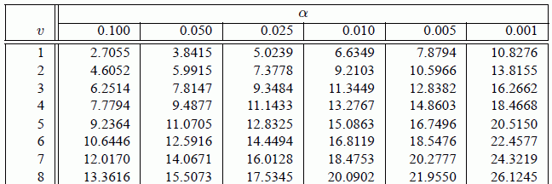
Likelihood ratio test
1105.9-1081.2= 24.7
1205-1204 = 1 DF => p < 0.001
Notes:
If you subtract the -2 log likelihoods from eachother you get 24.7. The null model had 1205 degrees of freedom, the model with one predictor has 1204, so the difference is 1. You can now look in a chi square table to see that with 1 degree of freedom the critical value for p = 0.001 is 10.8276. 24.7 is much higher, so p < 0.001. This means that the model with explanatory variable (exposure) is significantly better than the model without (the null model), same conclusion as from the Wald test.

Slide 16
Maximum Likelihood Estimation (MLE)
Subject | Status
1 | H
2 | D
3 | H
4 | H
5 | D
6 | H
7 | H
8 | H
9 | H
10 | H
11 | D
12 | H
What is the probability of suffering from disease in this cohort?
π = 3/12 = 25%
What is the likelihood of this observation?
π^3 * (1-π)^9= 0.001173
Notes:
How does the computer get at the maximum likelihood? Let’s have a look at a simple example in which it can actually be calculated. We have 12 subjects, out of which 3 developed disease. So the incidence is 25%. What is the likelihood of this observation? It is 0.25^3*(1-0.25)^9 = 0.001173. Let’s do this for ourselves in Excel.

Slide 17
π | Likelihood (π^3 * (1-π)^9)
0 | 0
0.1 | 0.000387
0.2 | 0.001074
0.3 | 0.00109
0.4 | 0.000645
0.5 | 0.000244
0.6 | 5.66E-05
0.7 | 6.75E-06
0.8 | 2.62E-07
0.9 | 7.29E-10
1 | 0
Notes:
Write in one column the possible values of Π, from 0 to 1, with increments of 0.1. Then in the column to the right enter the formula x^3*(1-x)^9 and copy downward. You will see that the highest results are at 0.2 and 0.3 so the maximum likelihood must be in between.

Slide 18
π | Likelihood (π^3 * (1-π)^9)
0.2 | 0.001074
0.21 | 0.00111
0.22 | 0.001138
0.23 | 0.001158
0.24 | 0.001169
0.25 | 0.001173
0.26 | 0.00117
0.27 | 0.001159
0.28 | 0.001141
0.29 | 0.001118
0.3 | 0.00109
Notes:
Now repeat what we did in a next column based on a minimum value of 0.2 and maximum of 0.3 with increments of 0.01. This time you see that the highest value must be between 0.24 and 0.25

Slide 19
π | Likelihood (π^3 * (1-π)^9)
0.245 | 0.00117225
0.246 | 0.00117259
0.247 | 0.00117286
0.248 | 0.00117305
0.249 | 0.00117316
0.25 | 0.00117320
0.251 | 0.00117316
0.252 | 0.00117305
0.253 | 0.00117286
0.254 | 0.00117260
0.255 | 0.00117227
Notes:
Now repeat what we did in a next column based on a minimum value of 0.24 and maximum of 0.25 with increments of 0.001. This time you see that the highest value is 0.25 itself. So the maximum likelihood is 0.25, which in this case corresponds with the incidence. It took us three iterations to get there.

Slide 20
Logistic regression and likelihood
Parameter estimates in logistic regression: obtained by maximum likelihood method
Likelihood values: found by trial and error algorithm (iteration), stopping once likelihood can no longer be increased
Command
Dependent variable - infection with microfilariae
. GLM.7 <- glm(mf ~ area, family=binomial, data=onch1302)
Independent variable - area of residence savannah vs. forest
Number of Fisher Scoring iterations: 4
Notes:
So you know now that in logistic regression we model on the log odds ratio and maximum likelihood estimation (MLE) is used to identify the best fitting model. Just like in linear regression, a model will always fit better if you add additional terms. What we are looking for is always the simplest possible model that is not significantly worse than a model with more terms, the principle of parcimony. In this slide you see another model fitted in R Commander, this time based on the ‘Onch1302’ dataset. The outcome is ‘mf’ (presence of micro filaria), the predictor is ‘area’ (living in the forest or in the savannah). As you can see R Commander used 4 iterations to find the best fit with maximum likelihood.

Slide 21
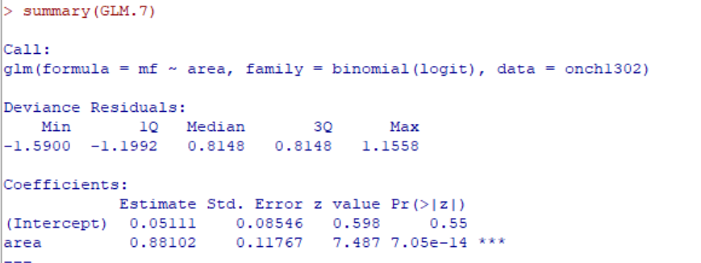
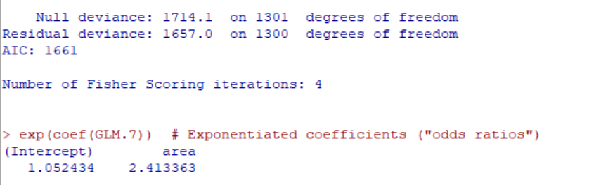
Area as predictor for presence of micro filaria (onch1302)
Notes:
Here you see the rest of the output. The log odds ratio for ‘area’ is 0.88102, if you exponentiate it you will get an odds ratio of 2.41. The P-value of the Wald test is highly significant (7.05 e-14). If you look at the null deviance, you see it is 1714.1, the residual deviance is 1657.1 with a difference of 1 degree of freedom (1301-1300). So Chi square is 57.1, with one degree of freedom, p < 0.0001. This means that the model with ‘area’ is significantly better than the null model in which the odds for ‘mf’ would not vary with area.

Slide 22
Area as predictor for presence of micro filaria (onch1302) Wald test
> summary(GLM.7)
Call:
glm(formula = mf ~ area, family = binomial, data = onch1302)
Coefficients:
Estimate Std. Error z value Pr(>|z|)
(Intercept) 0.05111 0.08546 0.598 0.55
area 0.88102 0.11767 7.487 7.05e-14 ***
---
Signif. codes: 0 ‘***’ 0.001 ‘**’ 0.01 ‘*’ 0.05 ‘.’ 0.1 ‘ ’ 1
> confint(GLM.7)
Waiting for profiling to be done...
2.5 % 97.5 %
(Intercept) -0.1163784 0.2188299
area 0.6511080 1.1125332
> exp(confint(GLM.7))
Waiting for profiling to be done...
2.5 % 97.5 %
(Intercept) 0.8901384 1.244620
area 1.9176644 3.042055
Notes:
On this slide you again see the log odds ratio of 0.88102 with its p-value. The command ‘Models’, ‘Confidence intervals’ also provides the confidence intervals for log odds ratio and odds ratio. For the former the association is statistically significant if 0 is not included, for the latter if 1 is not included in the confidence interval.

Slide 23
Likelihood ratio test for goodness of fit of a model
Likelihood ratio test for the whole model:
2(L₁-L₀) follows χ²-distribution with i d.f., with
L₀ = log likelihood of null model with equal odds in all exposure levels of all exposure variables
L₁ = maximum log likelihood of alternative model allowing for different odds at different levels in different variables of exposure
i = number of terms in model (levels of independent variables, interaction terms)
. GLM.1 <- glm(mf ~ area, family=binomial, data=onch1302) …
Null deviance: 1714.1 on 1301 degrees of freedom
Residual deviance: 1657.0 on 1300 degrees of freedom
The difference in log likelihoods (1714.1 – 1657.0) between the two models is significant at the 5% level (p < 0.0001), or …
... the alternative model is significantly better than the null model.
Notes:
As we already saw, the null deviance was 1714.1, the residual deviance was 1657.1 with a difference of 1 degree of freedom (1301-1300). So Chi square is 57.1, with one degree of freedom, p < 0.0001. This means that the model with ‘area’ is significantly better than the null model in which the odds for ‘mf’ would not vary with area.

Slide 24
Models with
> 1 exposure variable
Logistic regression provides OR estimates, adjusted for other variable(s):
Odds ratio for lesions: 6.67
If you have lesions you have 6.67 the odds for having infection
Call:
glm(formula = mf ~ area + lesions, family = binomial, data = onch1302)
Coefficients:
Estimate Std. Error z value Pr(>|z|)
(Intercept) -0.13878 0.08988 -1.544 0.123
area 0.85252 0.12120 7.034 2.01e-12 ***
lesions 1.89831 0.25089 7.566 3.84e-14 ***
Null deviance: 1714.1 on 1301 degrees of freedom
Residual deviance: 1572.5 on 1299 degrees of freedom
AIC: 1578.5
> exp(coef(GLM.8))
(Intercept) area lesions
0.8704226 2.3455483 6.6746077
> exp(confint(GLM.8))
2.5 % 97.5 %
(Intercept) 0.7294897 1.037851
area 1.8510053 2.977292
lesions 4.1863980 11.256051
Because its 2 variables, the 6.67 (from lesions), is already adjusted for Area
Is lesion addition a significant addition to the model?
(the wald test doesn’t say that)
For this we have to see the deviances
We need to compare the anova test (now the name of the test is likelihood ratio test) for see if a model of 1VI vs a model of 2 VI
Remember: LR-test for whole model, Wald tests (confidence intervals) for individual terms
Notes:
So far we had only one predictor, ‘area’ but the reason we use logistic regression is that it enables us to assess multiple predictors at the same time. We’ll start by adding the variable ‘lesions’ to the model, presence of skin lesions, ‘yes’ or ‘no’. Please note that both ‘area’ and ‘lesions’ have significant Wald tests. This is also clear when looking at the confidence intervals at the bottom of the slide, they both do not contain 1.
Also note the the deviance (-2 log likelihood) of the null model is still 1714.1 but that of the full model is now 1572.5, so Chi square is 141.6 with 1301-1299 = 2 degrees of freedom. This is highly significant but it compares a model with two terms to a null model. So the question still arises whether the model with two terms (area and lesions) is significantly better than the model with just one term (area only). If we look back at slide 21 we see that with only ‘area’ the -2 log likelihood was 1657.0 with 1300 degrees of freedom. So the difference with the model with 2 terms (areas and lesions) is 1657.0 – 1572.5= 84.5 with 1300 – 1299 degrees of freedom which is of course highly significant.

Slide 25
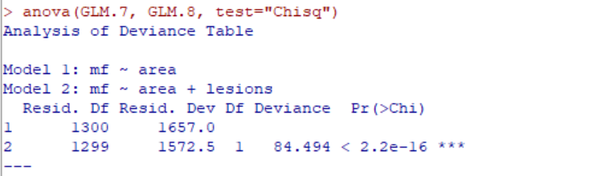
Models with
> 1 exposure variable
Comparison between two models:
Notes:
An easier way to do is is to use the command ‘Models’, ‘Hypothesis tests’, ‘Compare two models’ and select the two models, model 7 and 8 in my case. The output shows that Chi square is indeed 84.5 with 1 DF, p = 2.2 e-16. So the model with two terms is significantly better than the model with one term only.
A requirement for this to work is that the models must be hierarchical, i.e. the complex model must have all the terms of the simple model and the numbers of observations must be the same. The latter can be a problem if you have missing values for the additional variable. To solve such problem create a subset excluding the missing variables in both models.

Slide 26
Summary of 1st lecture (1)
Logistic regression …
overcomes limitations of stratified analysis
models log odds of disease: log odds(y) = b₀+b₁x₁+b₂x₂…+b_{i}x_{i}
obtains estimates by maximum likelihood approach
produces confidence intervals and test statistics:
Wald test for each term one by one
Likelihood Ratio test for whole model
To decide whether a complex model is better than a simpler model, use the likelihood ratio test

